Slide 1
Science with Dr. Christina Rahm We will get started shortly.

Slide 2
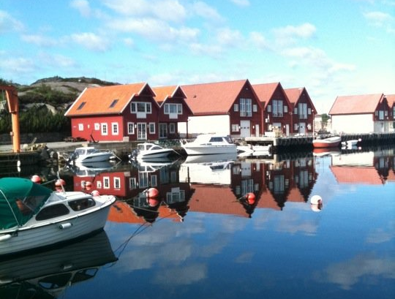
Dr. Dori Naerbo, Ph.D.
Notes:
Good morning, good afternoon, good evening…wherever you are in the world this is Dr. Dori Naerbo and I am your host on today’s call. For those of you who do not know me…I am a clinical researcher and author of several books.

Slide 4
Medical Disclaimer:
The information provided is for educational purposes and is not intended as medical advice, or a substitute for the medical advice of a physician or other qualified health care professional. This is for science and educational purposes only and cannot be used in any aspect for sales or marketing. You should not use this information for diagnosing a health or fitness problem or disease. You should always consult with a doctor or other health care professional for medical advice or information about diagnosis and treatment. This is Confidential. Do not distribute—for scientific educational purposes only.
Notes:
The information provided is for educational purposes and is not intended as medical advice, or a substitute for the medical advice of a physician or other qualified health care professional. This is for science and educational purposes only and cannot be used in any aspect for sales or marketing. You should not use this information for diagnosing a health or fitness problem or disease. You should always consult with a doctor or other health care professional for medical advice or information about diagnosis and treatment. This is Confidential. Do not distribute—for scientific educational purposes only.

Slide 5
ISNS Case Study Presented by: Dr. Norbert Ketskés

Slide 6
–ISNS Case Study – High Performance Athletes
The selection of appropriate foods and fluids is vital for the body to enhance recovery from exercise and improve sports performance.
Optimal nutrition along with timing of intake and supplement choices are strategies athletes use to improve performance.

Slide 7
Strategies
Dietary strategies include increasing intakes of macronutrients, micronutrients, and fluids. During high points of physical activity, carbohydrate and protein must be met to maintain body weight, replenish glycogen stores, and provide sufficient protein build and repair tissue.
Athletes who use severe weight-loss practices, restrict energy intake, eliminate one or more food groups from their diet, or consume unbalanced diets with low micronutrient density may require supplements. The use of dietary supplementation is popular in the athletic community, and some supplements may improve performance in specific tasks.

Slide 8
CONCENTRATION & ATTENTION IN SPORTS
Concentration and attention is vital for an athlete’s ability to perform well and make good decisions. Oftentimes, athletes are faced with a number of potential distractors.
External distractors could be visual or auditory, and may include other competitors, spectators, and media.
Internal distractors may include negative self-talk, fatigue, and emotional arousal.

Slide 9
PROPRIETARY BLENDS LEGEND
LEGEND
Proprietary blend I: silica, vitamin c, and trace minerals.
Proprietary blend II: N-acetyl L-tyrosine, anhydrous caffeine, L-theanine, velvet bean seed, pine bark, curcumin, and vitamin D
Proprietary blend III: black seed oil, resveratrol, turmeric, raspberry ketone, apple cider vinegar, aloe Vera, and d-ribose
Proprietary blend IV: Vitamin C, zinc sulfate, and vitamin D3
Proprietary blend V: Inulin, Green Banana flour, apple fiber, bacillus coagulans, spirulina, wheat grass, barley grass, alfalfa leaf, flax seed, psyllium husk powder, chlorella, broccoli, kale, spinach, green cabbage, parsley, aloe vera, cayenne pepper, blueberry powder, pomegranate seed powder, and MCT coconut oil powder
International Science and Nutrition Society – CURARE CAUSAM – ISNS 2021

Slide 10
CASE STUDY: PROPRIETARY BLENDS
PROPRIETARY BLEND II PROPRIETARY BLEND III
PROPRIETARY BLEND V
N-acetyl L-tyrosine, anhydrous caffeine, L-theanine, velvet bean seed, pine bark, curcumin, and vitamin D
Black seed oil, resveratrol, turmeric, raspberry ketone, apple cider vinegar, aloe Vera, and d-ribose
Proprietary Blend V is a powerful combination of natural vegetables, fruits, prebiotics, and probiotics, working in synergy to remove the body of unwanted toxins to support a healthy immune system.
International Science and Nutrition Society – CURARE CAUSAM – ISNS 2022

Slide 11
ISNS CASE STUDY 1:
Patient: Male
Age: 44-year-old
As an amateur boxer, he has won the World Cup twice and the European Cup twice. He also won a bronze medal once at a world championship and once at a European championship. He later continued his career as a professional boxer. In professional kick-boxing, he became the professional European champion of WPKC and WPKA (2002-2003) and then (2004-2005) the professional world champion. He was then awarded a contract in the Thai boxing rules system, where he won the professional world title of the above-mentioned organizations as well as the professional Thai boxing title of the WKA organization. After that, he continued his athletic career for four years as a professional cage fighter.
Now he works as a coach, working a minimum of 6-8 hours of intense training a day.

Slide 12
ISNS CASE STUDY 1:
Symptoms:
At our first consultation he had been getting realy tired lately, had joint and muscle pain, had concentration and digestive problems.
He felt physically weaker.

Slide 13
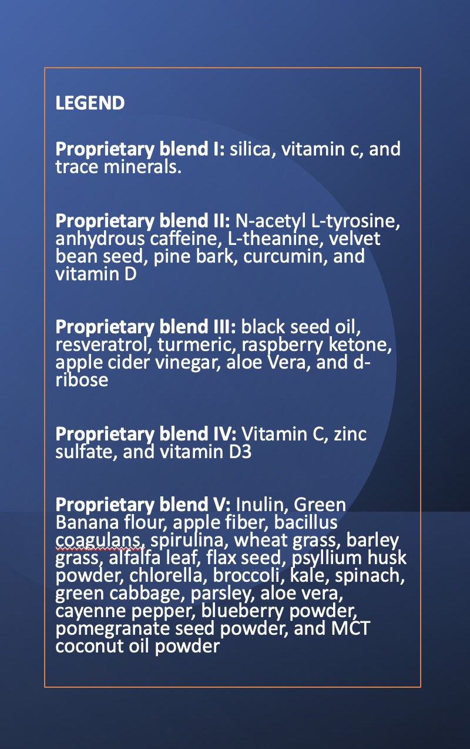
THERAPY
Proprietary blend II :1 in the morning for 3 days, then 2, 1 in the morning and 1 half an hour before training, then 3, 1 in the morning and 2 half an hour before training
Proprietary blend III:1 sachet in the morning, after 1 week, 1 sachet in the morning and 1 sachet after the training
Proprietary blend V : 1 teaspoon in the evening for 7 days, then 2 teaspoon in the morning and in the evening
International Science and Nutrition Society – CURARE CAUSAM – ISNS 2022

Slide 14
Result
After a few days, he felt stronger mentally and physically.
During the training, his consciousness was clear, he was able to maintain the concentration for the entire duration of the training.
.
After 2 weeks, his digestive problems disappeared and the concentration and the ability to react increased by about 50%.
The regeneration of the body is noticeably has been accelerated.

Slide 15
RESULTS-TESTIMONIAL
"Because of the sport, I tried a lot of energizing products. Unfortunately, the vast majority of them did not live up to their expectations. This may have been due to the fact that my body quickly got used to it. In contrast, these products WORKED VERY WELL. It also increased my physical and mental performance. It made me more energetic in training so that I could sleep soundly in the evening. He didn't spin too much, so I had no problem with regeneration. A very positive feature of the product is that it also increased my ability to concentrate. With other products, psychologically, a person becomes a little more tense. With this product, in addition to being able to concentrate better, I was able to stay completely calm. This allowed me to react quickly and accurately, in a controlled way, without error, to spontaneous struggling situations. Thank you for the products!!!"

Slide 16
ISNS CASE STUDY 2
Patient: Male
Age: 43-year-old
History: A 43-year-old male, a professional open-water swimmer – World record holder
He has completed the Ocean’s Seven series on 26 August 2019 which is the most challenging adventures for a human being. He became the 18th person to complete the Ocean’s Seven with the fastest cumulative time in history of 64 hours 33 minutes.
Stillwater 8 is the youngest of the open water swimming series. It was modeled on the Ocean’s Seven series, with the difference that all locations are in lakes.
Swimming on five continents of the earth has very variable and extreme characteristics. Wildlife is not a problem, but there are several locations in the series that are at an altitude. The length and temperature of the lakes are also very extreme. The length of the longest venue is approx. 65 km. Swimming at the highest altitude takes place at 3812 meters.

Slide 17
ISNS CASE STUDY 2
Lake Kineret, Israel Distance: 20.5 km Water temperature: 29 ° C
Symptoms:
Physically and mentally, he was tired sooner than before.
Lost focus, lost work out rhythm.
He wanted to increase his performance, only with natural active ingredients.
During swimming, he constantly consumed proprietary blend V.

Slide 18
THERAPY
Proprietary blend II :1 in the morning for 3 days, then 2, 1 in the morning and 1 half an hour before training, then 3, 1 in the morning and 2 half an hour before training
Proprietary blend III: 1 sachet in the morning and 1 sachet after the training
Proprietary blend V : 1 teaspoon in the evening for 7 days, then 2 teaspoon in the morning and in the evening (Even During swimming!!!!)
International Science and Nutrition Society – CURARE CAUSAM – ISNS 2022

Slide 19
Results
After 7 days, his ability to concentrate gradually increased and he was able to concentrate on tasks throughout the whole workout. After 3 weeks, the concentration and the ability to react quickly increased by about 40%.
Physically and mentally, he felt much better.
He was able to maintain concentration for the entire duration of the swim.

Slide 20
Research Studies
SEROTONIN AND DOPAMINE EFFECTS ON THE BRAIN

Slide 21
Serotonin and Stress
Francis Chaouloff Ph.D, Olivier Berton Ph.D & Pierre Mormède Ph.D
Forty-five years after its discovery, brain serotonin (5-HT) is still the subject of intense research aimed at understanding its role in stress adaptation. At the presynaptic level, numerous stressors increase nerve firing and extracellular 5-HT at the level of serotonergic cell bodies or nerve terminals. Different studies have reported stressor- and region-specific changes in extracellular 5-HT, a view challenged by electrophysiological and neurochemical evidence for a nonspecific response of serotonergic neurons to stressors when activity/arousal is taken into account. In addition, early studies indicate that stress-induced elevation in 5-HT synthesis, a key counter-regulatory process allowing serotonergic homeostasis, is mediated by specific neuroendocrine mechanisms. In addition to the multiplicity of postsynaptic 5-HT receptors and their specific regulation by corticoids, specificity to stressors is also underscored when considering one receptor type such as the 5-HT1A receptor. Stress studies should consider the past experience and the genetic status of the individual as key modulators of the serotonergic responses to stress.
https://www.nature.com/articles/1395332

Slide 22
Physical exercise-induced fatigue: the role of serotonergic and dopaminergic systems L.M.S. Cordeiro, P.C.R. Rabelo, M.M. Moraes, F. Teixeira-Coelho, C.C. Coimbra, S.P. Wanner, and D.D. Soares
Brain serotonin and dopamine are neurotransmitters related to fatigue, a feeling that leads to reduced intensity or interruption of physical exercises, thereby regulating performance. Physical training protocols induce neuroplasticity, thus modulating the action of these neurotransmitters in order to improve physical performance.
In general, studies with laboratory rodents and humans indicate that increased serotonergic activity and reduced dopaminergic activity are associated with accelerated fatigue.
https://www.ncbi.nlm.nih.gov/pmc/articles/PMC5649871/

Slide 23
THANKS FOR JOINING US TODAY!!!

